Slide 1
Internet Governance
Role of ICANN: Year 2017
Michael Yakushev, VP Eastern Europe | I-Forum | May 25, 2017

Slide 2
Internet Governance // Role of ICANN // Year 2017
What Internet Governance is
  ICANN post IANA
What ICANN is and what ICANN does
ICANN in countering cybercrime
KSK Rollover: October 2017
Q&A Answer

Slide 3
What Internet Governance is

Slide 4
Internet Governance: ‘Narrow’ and ‘Broad’ approach
Narrow approach: only technical aspects of Internet functioning
Broad approach: all related aspects should be taken into consideration (including access, multiculturalism and multilingualism, human rights, privacy etc.)
“Zero approach”: the issue of the ‘Red Button’

Slide 5
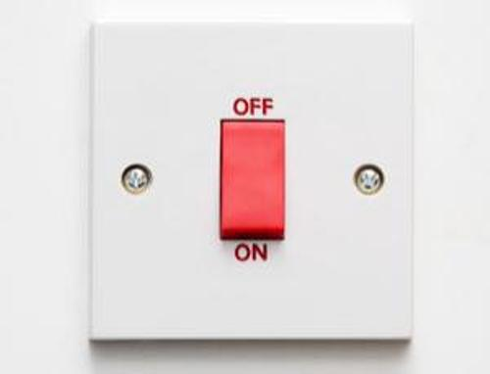
Is there any opportunity to switch off the Internet?

Slide 6

Where the “Red button” is located?

Slide 7
Multi-layer structure of the Internet Governance
Level 5: Internet Applications
  Web-sites, social networks, e-mail services, search engines etc.etc.
Level 4: Domain Names System
  Registries, Registrars, Domain names owners (administrators)
Level 3: IP Adresses Space
  IPv4 and IPv6 protocols (Regional Internet Registries)
Level 2: core DNS servers
  13 route servers DNS и 400+ mirrors (instances) worldwide
Level 1: Physical telecommunications channels
  Fiber optics, satellite channels, frequencies allocations, last miles and end-users equipment, local area networks etc.

Slide 8
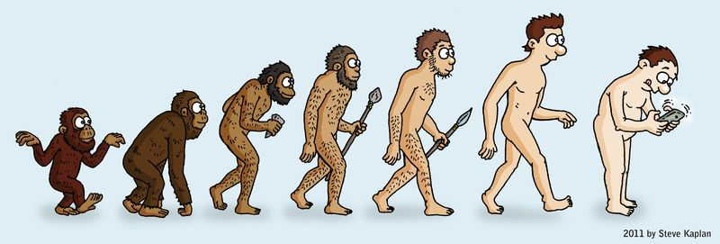
Internet Identifiers: Evolution
Applications,
Social Networks
Domain
Names
Search
argument
IP
Addresses
LAN OS
and MAC
Addresses
MAC
Addresses
Notes:
Use this slide for diagrams or other graphic elements.

Slide 9
What is Internet?
No legal definition so far
2005 г., Working Group on Internet Governance under U.N.Secretary General: «Self-explanatory. No need for any definition».
The most accurate wording: an information (-communication) networks, that unites computer systems worldwide (= in different countries), where the information flow is regulated by rules and standards, approved by a non-commercial Internet Society (Washingtion, DC)
Technological, not purely legal, regulation (RFC, RFP)

Slide 10
What is Internet Governance?
2005 г., Working Group on Internet Governance under U.N.Secretary General:
The development and application by Governments, the private sector and civil society, in their respective roles, of shared principles, norms, rules, decision-making procedures, and programs that shape the evolution and use of the Internet.
New Stakeholders: technical community, Academia, international organizations
Formats of IG: multi-stakeholders mechanisms (IGFs and other conferences), multilateral diplomacy (U.N. agencies etc.)

Slide 11
Multi-Stakeholderism
Hard to be translated to any foreign language
Interaction of all possible multistakeholders and groups of multistakeholders
  Governments + Private Sector + Civil Society (+ Technical Community + Academia + International Organizations)
  Not to be mixed with multi-lateral diplomacy
  Not to be mixed with e-democracy
  Not to be mixed with multiculturalism
Applicability to other spheres still under consideration (outer space, pharmaceuticals, nuclear energy for civil purposes)

Slide 12
What ICANN is
and what ICANN does

Slide 13
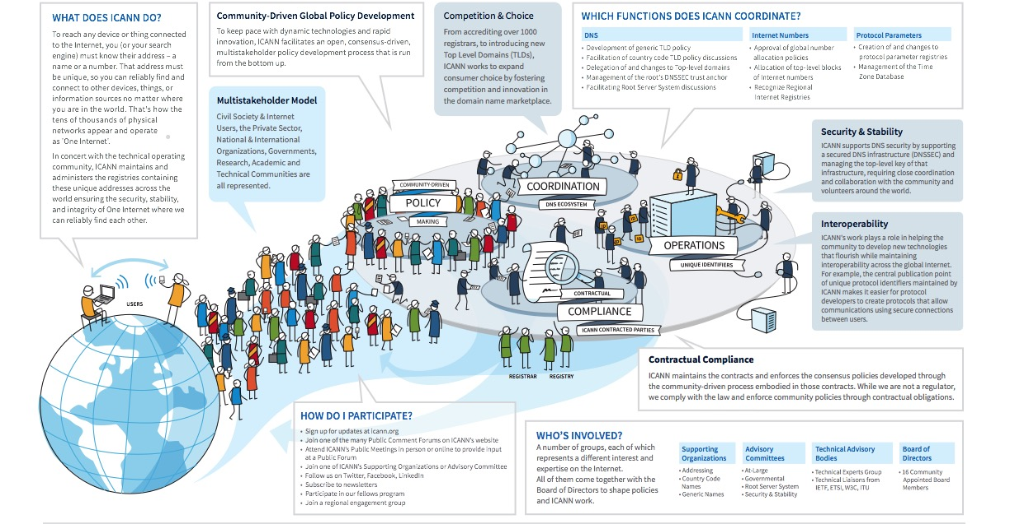
One World, One Internet

Slide 14
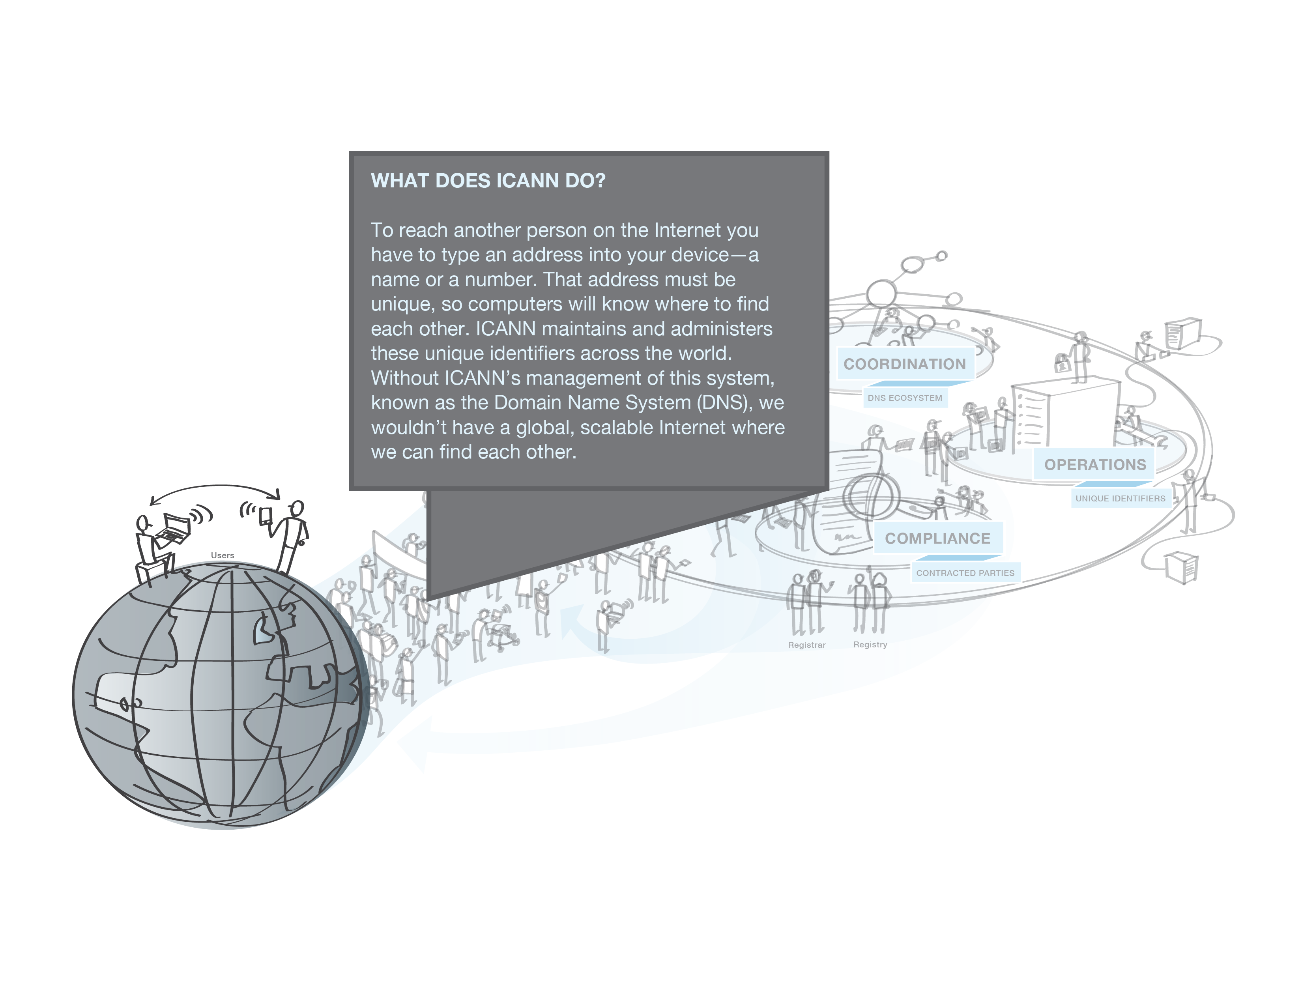
ICANN and DNS
The Internet Corporation for Assigned Names and Numbers

Slide 15
What does ICANN do?
Formed in 1998, ICANN is a not-for-profit corporation dedicated to keeping the Internet secure, stable and interoperable
ICANN coordinates:
    Allocation and assignment of three sets of unique identifiers of the Internet: domain names, IP addresses, and protocol parameters
    Operation and evolution of the DNS root name server system
    Policy development reasonably and appropriately related to these technical functions

Slide 16
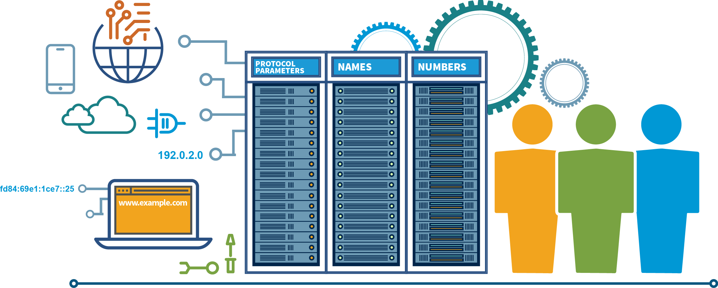
ICANN
Together with other participants
of the Global Internet Governance we work
on the security and stability of the global network

Slide 17
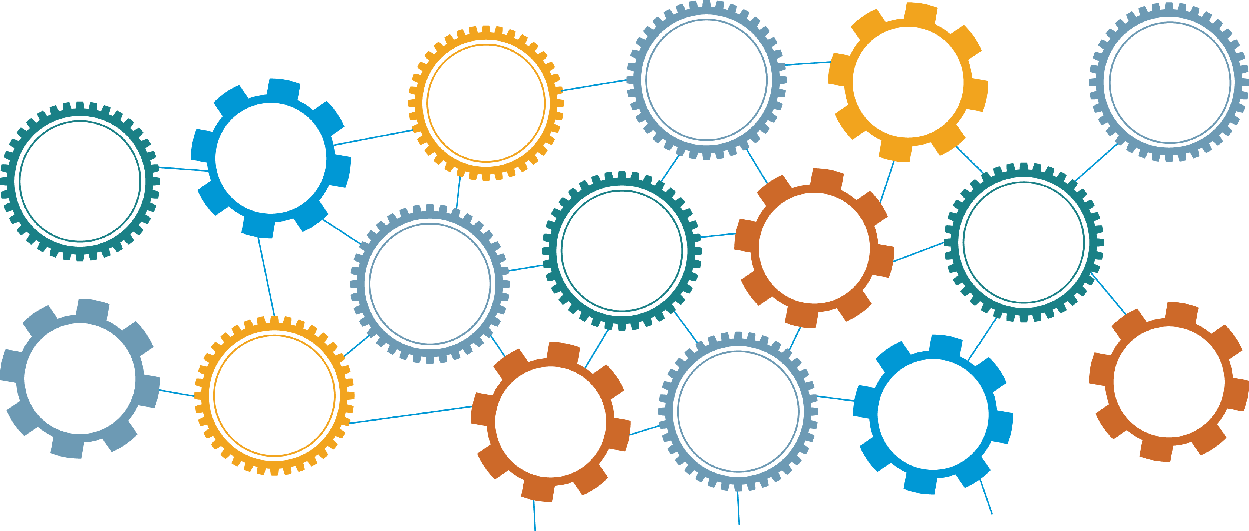
Technical Community of the Internet
Coordinating with our technical partners,
we help make the Internet work.
The Internet Corporation for Assigned Names and Numbers
African Network Information Center
Réseaux IP Européens Network Coordination Centre
Internet Service Providers
Internet Engineering Task Force
ation
International Organization for Standardization
American Registry for Internet Numbers
Institute of Electrical and Electronics Engineers
Domain Name System Operators
net
Root Server Operators
Latin America and Caribbean Network Information Center
Reg
Asia Pacific Network Information Centre
World Wide Web Consortium

Slide 18

Broader ICANN Community
We all work together in different ways
to help make the Internet work.
Diplo Foundation
The Anti- Phishing
Working Group
Inter-American Telecommunication Commission
International Organisation of La Francophone
World Intellectual Property Organization
The Messaging, Malware and Mobile Anti- Abuse Working
Group
The Internet Corporation for Assigned Names and Numbers
African Telecommunication Union
Regional Internet Governance Forums
Internet Governance Forum
United Nations Economic and Social Commission of Western Asia
Organization for Economic
Co-operation and Development
United Nations Educational, Scientific and Cultural Organization
European
Conference
of Postal
and Telecommunications Administrations
The Internet Society

Slide 19
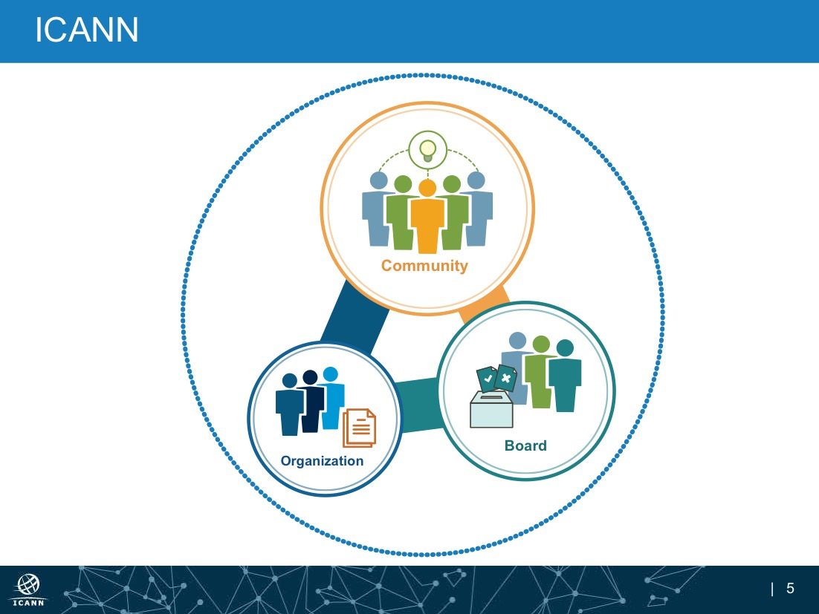

Slide 20





ICANN: who we are
A volunteer-based, open collection of global stakeholders, including: businesses, Internet engineers, technical experts, civil society, governments, end users and many others.
There are three supporting organizations in the ICANN community, representing: IP addresses, generic top-level domains (gTLDs), and country code top-level domains (ccTLDs). They develop policy recommendations in their respective areas. There are four advisory committees that give advice and recommendations. These are comprised of representatives of governments and international treaty organizations; representatives of root server operators; Internet security experts and Internet end users.
Works together through a
bottom-up process to give
advice, make policy
recommendations, conducts
reviews and proposes implementation solutions for common problems within ICANN’s mission and scope.
WHAT?
WHO?
Members are representatives from the Community, selected by their peers. The Board is
composed of 16 members and four non-voting liaisons, from different
geographies and with expertise relevant to ICANN's mission.
HOW?
A global organization, led by the CEO with
staff members in 40 countries, the ICANN
organization focuses staff & resources on:
policy development support, event management, registrars & registries support, Community support, contract compliance, IANA functions, outreach and capacity building, external services for the broader community (L-Root, WHOIS, etc.), & internal staff services.
Community
WHO?
Provides strategic oversight for the ICANN organization, ensuring the organization acts within its mission and operates effectively, efficiently and ethically, and considers community-developed policy recommendations.
WHO?
WHO?
WHAT?
The ICANN organization implements the Community’s recommendations at the direction of the Board, under the supervision of the CEO, within ICANN’s mission and scope.
Board
Organization
In accordance with the Bylaws, the ICANN Board approves Community policy. The Board directs the ICANN organization to implement. Board members act in what they believe to be the best interests of the global community. The Board acts by resolution, with information about decisions being provided openly and transparently.
WHAT?
HOW?
HOW?
HOW?
The ICANN organization is committed to accountable, transparent, inclusive and open operations and engagement, in cooperation with its partners.

Slide 21
ICANN Community
A volunteer-based, open collection of global stakeholders, including: businesses, Internet engineers, technical experts, civil society, governments, end users and many others.
There are three supporting organizations in the ICANN
community, representing: IP addresses, generic top-level
domains (gTLDs), and country code top-level domains
(ccTLDs). They develop policy recommendations in their respective areas. There are four advisory committees that give advice and recommendations. These are comprised of representatives of governments and international treaty organizations; representatives of root server operators; Internet security experts and Internet end users.
WHO?
WHAT?
Works together through a
bottom-up process to give
advice, make policy
recommendations, conducts
reviews and proposes implementation solutions for common problems within ICANN’s mission and scope.
HOW?
Community
Board
Organization

Slide 22
ICANN Board
Members are
representatives from the Community, selected by
their peers. The Board is
composed of 16 members and
four non-voting liaisons, from
different geographies and with expertise relevant to ICANN's
mission.
WHO?
Community
WHO?
ICANN Community
Provides strategic oversight for the ICANN organization, ensuring the organization
acts within its mission and operates effectively, efficiently and ethically, and considers community-developed policy recommendations.
WHAT?
Board
ICANN
Organization
WHAT?
Organization
HOW?
HOW?
In accordance with the Bylaws, the ICANN Board approves Community policy. The Board directs the ICANN organization to implement. Board members act in what they believe to be the best interests of the global community. The Board acts by resolution, with information about decisions being provided openly and transparently.
Notes:
I

Slide 23

ICANN Organization
A global organization, led by the CEO
with staff members in 40 countries,
the ICANN organization focuses staff & resources on: policy development support, event management, registrars & registries support, Community support, contract compliance, IANA functions, outreach and capacity building, external services for the broader community (L-Root, WHOIS, etc.), & internal staff services.
Community
WHO?
Board
The ICANN organization implements the Community’s recommendations at the direction of the Board, under the supervision of the CEO, within ICANN’s mission and scope.
WHAT?
Organization
HOW?
The ICANN organization is committed to accountable, transparent, inclusive and open operations and engagement, in cooperation with its partners.

Slide 24
Policy Development Process
IDENTIFY AND SCOPE THE ISSUE
BOARD VOTES
1
3
5
Supporting organizations identify, initiate and create policy
DRAFT
POLICY RECS
Submit final report to Board
Identify issue
Address Supporting Organization
Implementation
Public comments
by Community
Issue report
Country Code Names Supporting Organization
Consult with Community and produce policy
Board votes on final policy
POLICY
RECS
FINAL POLICY
Initiate policy development process
Call for volunteers to develop policy
Generic Names Supporting Organization
2
DEVELOP POLICY
4
VOTING OR REVIEW
Advisory Committees can participate during the process
At-Large Advisory Committee
Security and Stability Advisory Committee
Root Server System Advisory Committee
Government Advisory Committee
Notes:
.

Slide 25
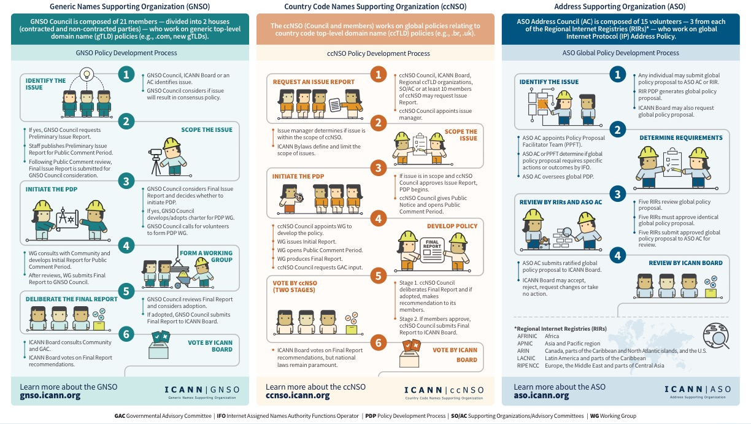
Supporting Organizations of ICANN

Slide 26

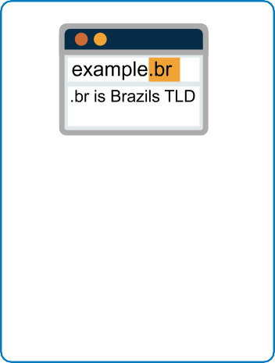


ICANN: what we are working on
POLICY
ADDRESS
Domain Name System
The domain name system provides addressing for the Internet so people can find websites, send email, and other tasks. The ICANN organization also supports the stability of the DNS through its work, and also its contracts and accreditations.
Policy Development
The ICANN organization supports inclusive, open and transparent multi-stakeholder bottom-up consensus based policy development mechanisms.
L-Root
The ICANN organization hosts and supports one of the 13 L-Root infrastructures. At over 150 locations worldwide, L-Root is critical to infrastructure that helps reduce latency and improves performance of the DNS.
Support and Grow the Community
The ICANN organization engages, nurtures and supports interested stakeholders for active and meaningful participation in ICANN. ICANN connects with stakeholders through outreach and engagement, and meeting & event support.
Generic Top-Level Domains
The ICANN organization manages the domain name system's top-level domains. ICANN helps promotes competition and choice in the gTLD marketplace.
Country Code Top-Level Domains
The ICANN organization delegates top-level domains identified with a country code. Management is done by national ccTLD operators.
Protocol Parameters
The ICANN organization, in coordination with the Internet Engineering Task Force, manages protocol parameters by maintaining many of the codes and numbers used in Internet protocols.
Internet Protocol Addresses
By serving as the central repository for IP addresses, the ICANN organization helps coordinate how IP addresses are supplied – preventing repetition and conflicts.
Root Zone Management
The ICANN organization helps manage the root zone through the IANA functions, which involves assigning the operators of top-level domains, such as .bank and .com, and maintaining the technical and administrative details.
IANA Functions

Slide 27
IDN Country Code Top-Level Domains
IDN ccTLD Fast Track Process
Countries/Territories: 36
укр
(ua)
рф
(ru)
भारत
بھارت
భారత్
ભારત
ਭਾਰਤ
ভারত
இந்தியா
(in)
бел
(by)
ccTLDs: 46
გე
(ge)
հայ
(am)
срб
(rs)
қаз
(kz)
Мон (mn)
سورية
한국
(kr)
мкд
(mk)
(sy)
عراق
پاکستان
(pk)
المغرب
(ma)
فلسطين
(iq)
(ps)
ایران
বাংলা
(bd)
中国中國
(cn)
الجزائر
(dz)
مصر
(eg)
(ir)
台灣
台湾
(tw)
السعودية
تونس
(tn)
(sa)
عمان
سودان
(sd)
ไทย
(th)
香港
(hk)
(om)
澳門(mo)
امارات
الاردن
(ae)
(jo)
قطر
ලංකා
இலங்கை
(lk)
新加坡
சிங்கப்பூர்
(sg)
اليمن
(qa)
(ye)
مليسيا
(my)

Slide 28
Focus on ICANN 5-Year Strategic Goals (FY16-FY20)
Further globalize/internationalize and regionalize ICANN functions
Bring ICANN to the world by creating a balanced and proactive approach to regional engagement with stakeholders
Support the evolution of the domain name marketplace to be robust, stable and trusted
Encourage engagement with the existing Internet governance ecosystem at national, regional and global levels
Establish mechanisms to increase trust within the ecosystem rooted in the public interest and within ICANN’s remit
Empower current and new stakeholders to fully participate in ICANN activities

Slide 29
Possible topics for interaction
Glossary of applied terminology
Regulation of identifiers on new stages of New gTLD launch
Network identification on global level
Role of every stakeholder, inside and outside Ukraine: National Cyber Strategy
Ban (control) of the cyber warfare
Awareness raising and capacity building programs
Training for law-enforcement agencies
Joint investigation of incidents and cybercrimes
Harmonization of domestic legal regulation
Participation in IG processes on global level
Notes:
Government cannot do this alone, industry can not do this alone.

Slide 30
Main Focus Areas
Security, stability and resiliency of the system of unique identifiers (global Internet infrastructure)
1
2
DNS Industry: prosperity for national economy
3
ICANN-related policy making process

Slide 31
Regional Strategic Objectives
Regional Strategy as part of the corporate
Strategy of ICANN
Compliance with the global strategies and goals
Due time and adequate allocation of resources
Sharing best practices from other regions and countries
Cross-regional interaction
Objective 1
ICANN as a trusted point of expertise for DNS functionality, stability, security and resiliency with respect to local context
Objective 2
Focused and in-depth work with stakeholders to make engagement with ICANN mutually beneficial

Slide 32
Done with #IANA transition, what now (1)?
Sharing ICANN expertise at industry events in the region (IGFs, TLDCON, CyberCrimeCon, Eastern European DNS Forum etc)
Facilitating Cybercrime trainings for Law Enforcement agencies with SSR team
Facilitating few L-root instances instalation
Conducting new gTLDs briefings for local media
Webinar updates (what would you like to be hearing about next time? Would you like to host it next time?)

Slide 33
Done with #IANA transition, what now (2)?
Looking for more engagement with academia
KSK Rollover updates – watch the space in the next 1,5 years!
Facilitating IDN label generation panels (Cyrillic, Georgian, Armenian, …) work
  Universal acceptance
Growing more ICANN accredited registrars
Promoting NextGen and Fellowship engagement

Slide 34
ICANN
in countering cybercrime

Slide 35

One Internet, Many Identifier Systems
Addresses identify locations of Internet devices or hosts
  IP version 4
  IP version 6
Domain names provide user friendly identification of hosts
  Latin script (A-Z, 0-9, and hyphen)
  Internationalized Domain Names accommodate non-Latin languages or scripts
ICANN coordinates
the administration
of global identifier systems

Slide 36
One Internet, Many Identifier Systems
Port numbers identify Internet application endpoints, e.g.,
  A browser and a web server
  Called and calling parties of an Internet telephony connection
Parameters identify numbers that Internet protocols need to operate correctly
  Uniform resource identifiers
  Character encodings
  Values for specific protocol fields
Identifier systems
are managed in
databases or
“registries”

Slide 37
What is the Domain Name Space?
The formal structure of the DNS database is
an inverted tree with the root node at the top
The root node is designated using a terminating “dot”
Each node has a label
root node
top-level node
top-level node
top-level node
2nd-level node
2nd-level node
2nd-level node
2nd-level node
2nd-level node
3rd-level node
3rd-level node
3rd-level node
The DNS is a public name space.
It is one of many name spaces used on the Internet

Slide 38
Labels and Domain Names
Each node in the DNS name space has a label
The domain name of a node is the list of the labels on the path from the node to the root of the DNS
The root node
”.”
root node
Top Level Domain
e.g.
COM
top-level node
The domain name for the
node circled in RED is
www.example.com.
this is called a
FULLY QUALIFIED DOMAIN NAME (FQDN)
FQDNs are globally unique in the public DNS
2nd-level node
2nd-level node
2nd Level Domain
e.g.
EXAMPLE
3rd-level node
3rd Level Domain
e.g.
WWW

Slide 39
Top Level Domains
Top Level Domains are delegated from the root of the DNS
Generic Top Level Domains are operated by registry operators under contract to ICANN
Country code Top Level Domains are operated by a registry operator designated by a sovereign nation
Internationalized Domain names may use non-Latin characters
...
...
Names in generic Top Level Domains
Names in country-code TLDs
org
gov
com
AF
ZW
icann
ncfta
irs
ftc
google
msn
co
www
ssac
google
Notes:
This is a simpler agenda slide, the outline for your presentation.

Slide 40
Who’s Who in the DNS Ecosytem?
Manage top-level domain (TLD) databases and generate TLD zone files
Registry operators may be
  Large corporations,
  For- or non-profit organizations
  Departments in universities
  Government agencies
  May outsource back-end operations
Registries

Slide 41
Top Level Domain Registries
gTLD registry operators contract with ICANN
  Must comply with ICANN policy
  http://www.icann.org/en/resources/registries/listing
ccTLDs do not have contracts with ICANN
  May participate in ICANN policy via the CC Name Supporting Organzation
  May have different registration or Whois services from gTLDs
  http://www.iana.org/domains/root/db
  http://ccnso.icann.org
gTLDs
ccTLDs

Slide 42
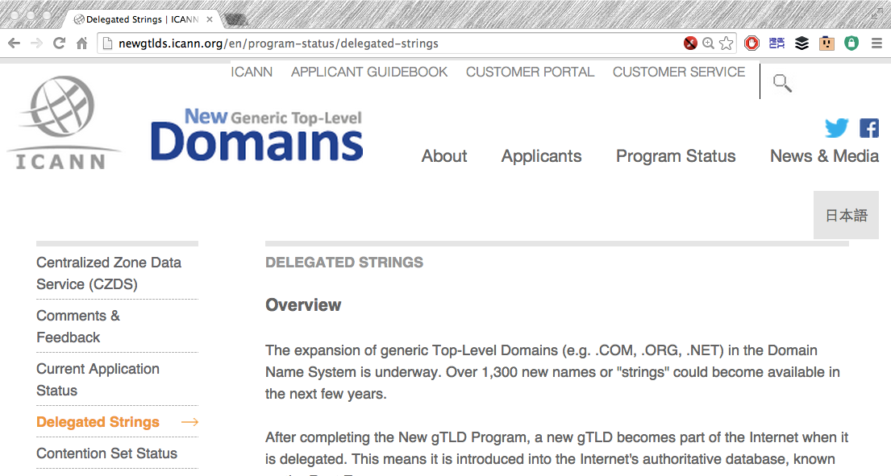
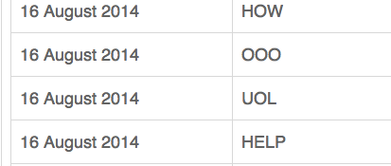
New Top Level Domains
nTLDs
New TLDs are listed at ICANN as they are added to the root zone
http://newgtlds.icann.org/en/program-status/delegated-strings
https://newgtlds.icann.org/newgtlds.csv
Unrestricted access
(no account required)

Slide 43
Registrars
Business entities that process domain name registrations
  In GTLD space all registrars must be ICANN accredited and are subject to Registrar Accreditation Agreement (RAA)
    https://www.icann.org/resources/pages/approved-with-specs-2013-09-17-en
    http://www.icann.org/registrar-reports/accredited-list.html
  CcTLDs define their own registration processes
    Some use ICANN accreditation or similar accreditation
Retail and “wholesale” (reseller) business models
Providing registration services is not an exclusive business
Registrars
43

Slide 44

Domain name “directory assistance”
How does a resolver find the IP address of WWW.ICANN.ORG?
Resolvers find answers by asking questions iteratively
m.root-servers.net
Here’s a list of ORG TLD name servers.
Ask one of these.
Ask root name servers for
IPv6 address of www.icann.org
Here’s a list of ICANN name servers.
Ask one of these.
a0.org.afilias-nst.info
Ask a0.org.afilias-nst.info
for IPv6 address of www.icann.org
dns1.icann.org
The IPv6 adddress of www.icann.org
2001:500:88:200::7
Ask ns.icann.org for
for IPv6 address of www.icann.org
ns.icann.org

Slide 45
DNS zone data
Zone data are hosted at an authoritative name server
Each “cut” has zone data (root, TLD, delegations)
Zones contain resource records that describe
  name servers,
  IP addresses,
  Hosts,
  Services
  Cryptographic keys & signatures…
  Only US ASCII-7 letters, digits, and hyphens
  can be used as zone data.
  In a zone, IDNs strings begin with XN--

Slide 46
DNS zone data
Zone data are hosted at an authoritative name server
Each “cut” has zone data (root, TLD, delegations)
Zones contain resource records that describe
  name servers,
  IP addresses,
  Hosts,
  Services
  Cryptographic keys & signatures…
  Only US ASCII-7 letters, digits, and hyphens
  can be used as zone data.
  In a zone, IDNs strings begin with XN--

Slide 47
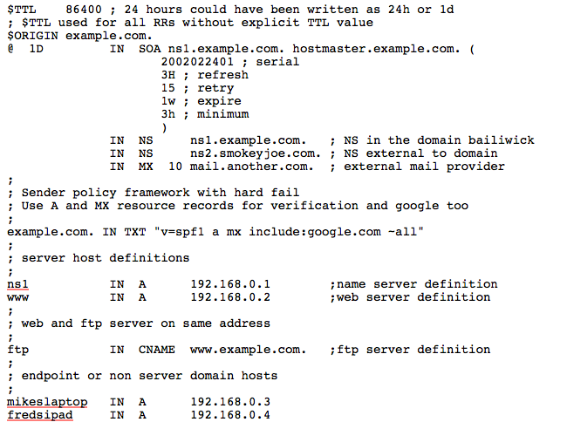
Common DNS Resource Records
Time to live (TTL)
How long RRs are accurate
Start of Authority (SOA) RR
Source: zone created here
Administrator’s email
Revision number of zone file
Name Server (NS)
IN (Internet)
Name of authoritative server
Mail Server (MX)
IN (Internet)
Name of mail server
Sender Policy Framework (TXT)
Authorized mail senders

Slide 48
Common DNS Resource Records
Name server address record
NS1 (name server name)
IN (Internet)
A (IPv4) * AAAA is IPv6
IPv4 address (192.168.0.1)
Web server address record
www (world wide web)
IN (Internet)
A (IPv4), AAAA (IPv6)
e.g., 192.168.0.2
File server address record
FTP (file transfer protocol)
IN (Internet)
CNAME means “same address spaces and numbers as www”

Slide 49
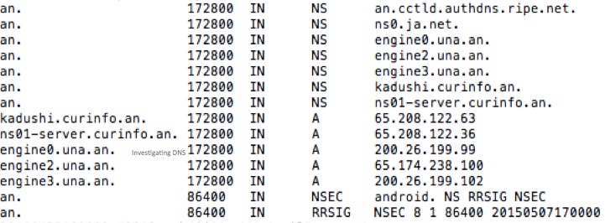
Root zone data
The root zone contains delegated top level domain information
You can copy the root zone from http://www.internic.net/domain/root.zone
Name server records (NS)
Name server addresses (A, AAAA)
Cryptographic records (DS, RRSIG, DNSKEY, NSEC)

Slide 50
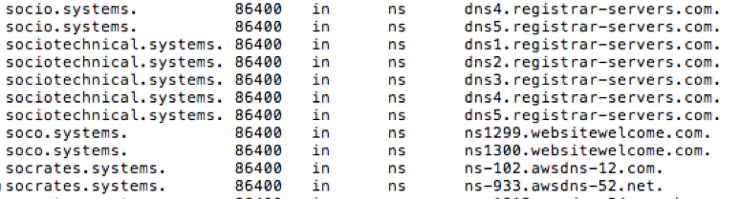
Top Level Domain zone data
The TLD zones contain delegated domain information
The most important records for investigators are
Name server records (NS)
IP address records for name servers (A, AAAA)

Slide 51
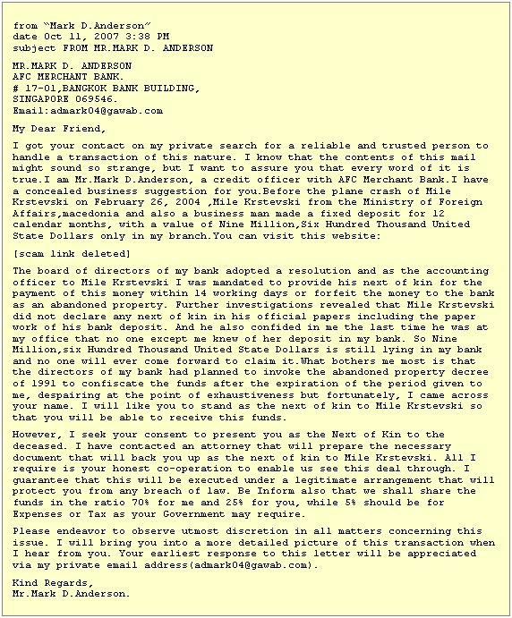

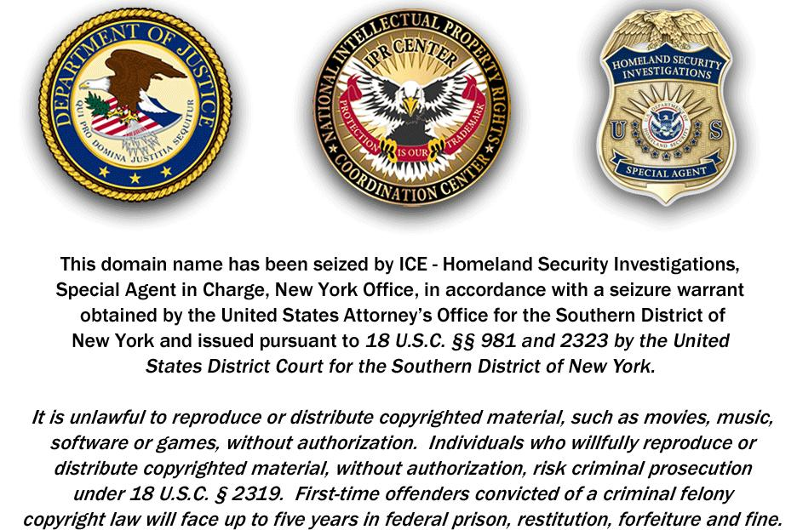
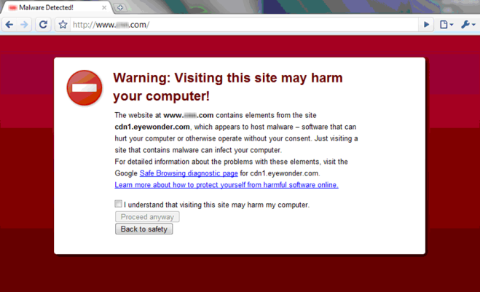
Maliciously Registered Domain Names
Domains registered by criminals for
  Counterfeit goods
  Data exfiltration
  Exploit attacks
  Illegal pharma
  Infrastructure (ecrime name resolution)
  Malware C&C
  Malware distribution, ransomware
  Phishing, Business Email Compromise
  Scams (419, reshipping, stranded traveler…)

Slide 52
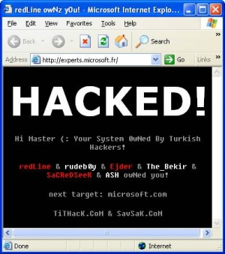


Misused Domain Registrations
Domains compromised or hijacked by criminals or state-sponsored actors
  Host criminal DNS infrastructure
  Domain, NS, or MX Hijacking
  Hacktivism (e.g., defacement)
  Tunneling (covert communications)
  Data Exfiltration
  Methods
  Infection (Malware)
  Configuration change (DNSChanger)
  Poisoning (resolver/ISP)
  Man in the Middle attacks (insertion, capture)
52

Slide 53

Collecting Evidence of DNS Abuse/Misuse
Recent domain registration creation date
Questionable Whois contact data
Privacy protection service
Suspicious values in DNS Zone data (e.g., TTL)
Spoofing or confusing use of a brand
Known DGA or malware control point
Hosted on suspicious/notorious name servers
High frequency/volume of name errors
Suspicious (notorious) hosting location
Suspicious (notorious) service operator
Base site content is non-existent or bad
Linked content is suspicious or bad
Suspicious mail headers, sender, or content
Analogs:
Number of matching minutiae
Body of evidence
http://www.flickr.com/photos/vincealongi/

Slide 54
Not always easy to identify abuse
Criminals Use Obfuscation
Redirection: hacked sites use URL shorteners
Recursion: Shortened URLs are shortened
One-time use URLs
Add subdomains to zone at a hacked DNS server
Country- or script-specific content; non-visible content
Privacy-protected domain registrations
Whois Point of Contact information culled from obituaries
Criminals use impersonation
Criminals hide in plain sight
  They operate from legitimate or compromised resources

Slide 55
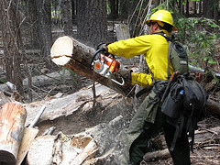
Chainsaw, scalpel or laser?
Domain name “takedown”
  Contact Registry, registrar,
  or DNS hosting provider
  DNS will not resolve name
  DNS will resolve name to sinkhole
  Try AUP violation, may require court order
This action is broadly disruptive
  All subdomains will become unreachable
  All content is taken offline
  All users of all services
Domain takedown

Slide 56

Chainsaw, scalpel or laser?
Take (malicious) content offline
  Contact content hosting provider
  Minimizes harm, not always easy
  Try AUP violation, may require court order
This action affects targeted content only
  No assurance that content is removed (forever)
Content
takedown

Slide 57

Chainsaw, scalpel or laser?
Blocking content (or traffic)
  Contact reputation service
  provider (blocklisting org)
  Most granular action
    Can be applied to TLD, ASN,
    domain, IP, or URL
  Done independently from AUP, court order
Minimally intrusive but highly localized,
  Only protects parties protected by blocklist(s)
  Content may remain online
  May be temporary/stop gap only
  Names will continue to resolve
Block listing

Slide 58
What Hinders Mitigation or Prosecution?
JURISDICTION | What is the prevailing jurisdiction of content hosting, DNS hosting, domain registration, alleged perpetrators?
LAW | Is this a criminal activity in all relevant jurisdictions?
CONTRACT, INTERPRETATION | Is a contracted party in breach of an obligation? According to whose interpretation?

Slide 59

Who? What? When? Where? How?
Who is the target of your action?
  Registrant
  Hosting operator (Web, Mail, DNS…)
  Network (ISP)
  Registrar (or reseller),
  Registry Operator
What is the goal of the action?
When will you act? In synchrony with others?
Where in the world are the people, content, networks, or systems that you’re targeting?
How will you take action?
  Court order, acceptable use, compliance violation

Slide 60
What do you want the DNS to do?
How should DNS respond to queries for seized domains?
  Is name resolution service (DNS) to be suspended?
  Is redirection to a text of notice page required?
  Is redirection of Internet hosting required?
Who will operate DNS for seized domains?
    Is the party that provides name resolution service (DNS) to be changed?

Slide 61
What should Whois display?
Is the domain name to be transferred to a different sponsoring registrar?
Are you transferring the registration? To whom?
What name server is hosting name resolution?
What status should the registry set for the domain?
  E.g., prevent transfer, update, or delete?

Slide 62
Have you minimized collateral harm?
Examples of questions to ask before you file:
Will your action disrupt
  Name service for other (reputable) domains?
  Hosting services for parties other than those named in your order?
What services other than web are affected by your action on the domain name?
What do you expect as the “long term disposition” of the domain name?
Could your actions interfere with other active investigations, monitoring, surveillance… ?
Read Is Jotform a Poster Child for Domain Takedown Overkill?
http://www.securityskeptic.com/2012/02/is-jotform-a-poster-child-for-domain-shutdown-overkill.html

Slide 63
Steps to investigate domains
Collect evidence of abuse
  The purpose of this course is to show ways to do this
Determine hosting provider or registrar
    Is there a reseller of that registrar involved?
Contact hosting provider or registrar abuse desk
    Provide evidence of abuse
    Point out registration problems
    Ask if TOS ,ICANN, ccTLD registry domain suspension policy applies
No success? Contact registry
  Same supporting info as registrar
Escalate
    Sharing/intel networks
    National CERT or local LE
    Whois Data Problem Reporting System
    ICANN compliance
If you are looking at a suspicious domain, someone else is, too.

Slide 64
DNSSEC: Important Update on KSK Rollover
Notes:
Breakup your presentation, divide it into sections. This is especially useful if most of your presentation is text.

Slide 65
KSK Rollover: An Overview
ICANN is in the process of performing a Root Zone DNS
Security Extensions (DNSSEC) Key Signing Key (KSK) rollover
The Root Zone DNSSEC Key Signing Key “KSK” is the top most cryptographic key in the DNSSEC hierarchy
The KSK is a cryptographic public-private key pair:
  Public part: trusted starting point for DNSSEC validation
  Private part: signs the Zone Signing Key (ZSK)
Builds a “chain of trust” of successive keys and signatures to validate the authenticity of any DNSSEC signed data
KSK
DATA

Slide 66

Why is ICANN Rolling the KSK?
As with passwords, the cryptographic keys used in DNSSEC-signing DNS data should be changed periodically
  Ensures infrastructure can support key change in case of emergency
This type of change has never before occurred at the root level
  There has been one functional, operational Root Zone DNSSEC KSK since 2010
The KSK rollover must be widely and carefully coordinated to ensure that it does not interfere with normal operations

Slide 67
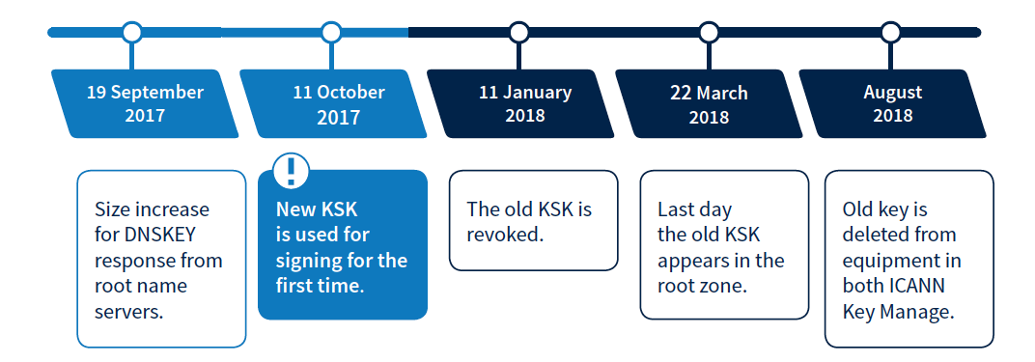
When Does the Rollover Take Place?
The KSK rollover is a process, not a single event
The following dates are key milestones in the process when end users may experience interruption in Internet services:

Slide 68
Who Will Be Impacted?
DNS Software Developers & Distributors
System Integrators
Network Operators
Internet Service Providers
End
Users
(if no action taken by resolver operators)
Root Server Operators

Slide 69
Why You Need to Prepare
If you have enabled DNSSEC validation, you must update your systems with the new KSK to help ensure trouble-free Internet access for users
Currently, 25 percent of global Internet users, or 750 million people, use DNSSEC-validating resolvers that could be affected by the KSK rollover
If these validating resolvers do not have the new key when the KSK is rolled, end users relying on those resolvers will encounter errors and be unable to access the Internet

Slide 70
What Do Operators Need to Do?
Be aware whether DNSSEC is enabled in your servers
Be aware of how trust is evaluated in your operations
Test/verify your set ups
Inspect configuration files, are they (also) up to date?
If DNSSEC validation is enabled or planned in your system
  Have a plan for participating in the KSK rollover
  Know the dates, know the symptoms, solutions

Slide 71
How To Update Your System
If your software supports automated updates of DNSSEC trust anchors (RFC 5011):
If your software does not support automated updates of DNSSEC trust anchors (RFC 5011) or is not configured to use it:
The KSK will be updated automatically at the appropriate time
You do not need to take additional action
  Devices that are offline during the rollover will have to be updated manually if they are brought online after the rollover is finished
The software’s trust anchor file must be manually updated
The new root zone KSK is now available here after March 2017:
http://data.iana.org/
root-anchors/

Slide 72
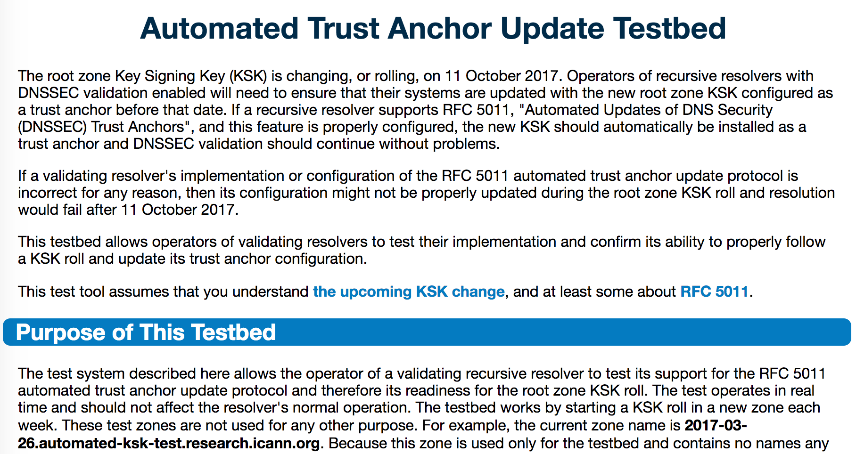
Check to See If Your Systems Are Ready
ICANN is offering a test bed for operators or any interested parties to confirm that their systems handle the automated update process correctly.
Check to make sure your
systems are ready by visiting:
go.icann.org/KSKtest

Slide 73
Three Steps to Recovery
If your DNSSEC validation fails after the key role:
Stop the tickets
It's OK to turn off DNSSEC validation while you fix (but remember to turn it back on!)
Debug
If the problem is the trust anchor, find out why it isn't correct
  Did RFC 5011 fail? Did configuration tools fail to update the key?
  If the problem is fragmentation related, make sure TCP is enabled and/or make other transport adjustments
Test the recovery
Make sure your fixes take hold

Slide 74
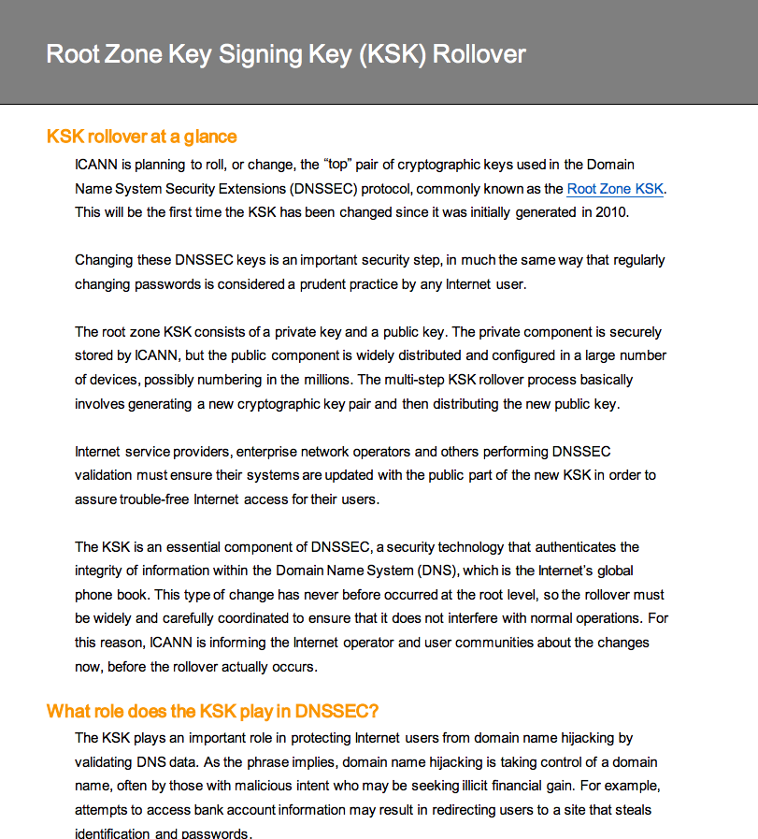
Quick Look
Links:
EN: https://www.icann.org/en/system/files/files/ksk-rollover-at-a-glance-22jul16-en.pdf
ES: https://www.icann.org/es/system/files/files/ksk-rollover-at-a-glance-22jul16-es.pdf
FR: https://www.icann.org/fr/system/files/files/ksk-rollover-at-a-glance-22jul16-fr.pdf
AR: https://www.icann.org/ar/system/files/files/ksk-rollover-at-a-glance-22jul16-ar.pdf
PT: https://www.icann.org/pt/system/files/files/ksk-rollover-at-a-glance-22jul16-pt.pdf
RU: https://www.icann.org/ru/system/files/files/ksk-rollover-at-a-glance-22jul16-ru.pdf
ZH: https://www.icann.org/zh/system/files/files/ksk-rollover-at-a-glance-22jul16-zh.pdf

Slide 75
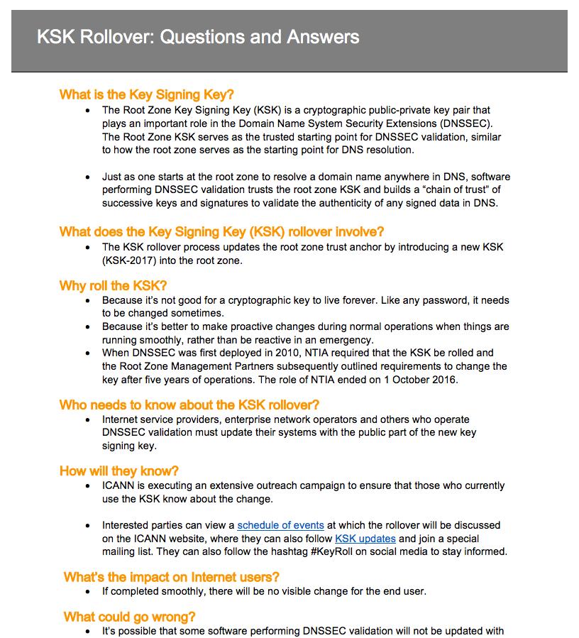
Q&A
Links:
EN: https://www.icann.org/en/system/files/files/ksk-rollover-questions-answers-31oct16-en.pdf
ES: https://www.icann.org/resources/pages/ksk-rollover-2016-07-27-es
FR: https://www.icann.org/fr/system/files/files/ksk-rollover-questions-answers-31oct16-fr.pdf
AR: https://www.icann.org/ar/system/files/files/ksk-rollover-questions-answers-31oct16-ar.pdf
PT: https://www.icann.org/pt/system/files/files/ksk-rollover-questions-answers-31oct16-pt.pdf
RU: https://www.icann.org/ru/system/files/files/ksk-rollover-questions-answers-31oct16-ru.pdf
ZH: https://www.icann.org/zh/system/files/files/ksk-rollover-questions-answers-31oct16-zh.pdf

Slide 76
Consclusions.
Questions?

Slide 77
Welcome to ICANN
General information on ICANN: https://www.icann.org/ru
How can I participate? https://www.icann.org/resources/pages/beginners-guides-2012-03-06-en
Policy developing process: https://www.icann.org/policy#what_is_policy
Security and Stability Advisory Committee: https://www.icann.org/groups/ssac
ICANN 58 in Copenhagen (March 2017): https://meetings.icann.org/en/copenhagen58
ICANN Meetings in 2017 г (Johannesburg, June, and Abu Dhabi, October-November https://meetings.icann.org/en/calendar)
Fellowship Program https://www.icann.org/fellowshipprogram

Slide 78
Participation in ICANN
Attend ICANN public meeting in person or remotely
  https://meetings.icann.org
Join ICANN’s online public comments forum
  https://www.icann.org/public-comments
Apply for an ICANN fellowship
  https://www.icann.org/resources/pages/fellowships-2012-02-25-en
Participate in the quarterly stakeholder calls
  https://www.icann.org/news/announcement-2015-01-13-en
Join one of ICANN constituencies
  https://www.icann.org/resources/pages/how-2012-02-25-en

Slide 79








Thank you! We wish you a successful IGF in Tbilisi !
Engage with ICANN
Reach us at:
Email: Michael.Yakushev@icann.org
Website: icann.org
  New gTLD website: newgtlds.icann.org
twitter.com/icann_ru
gplus.to/icann
facebook.com/icannorg
weibo.com/ICANNorg
linkedin.com/company/icann
flickr.com/photos/icann
youtube.com/user/icannnews
slideshare.net/icannpresentations
Notes:
You can adjust the email/web address to whichever email or web address is best suited to your presentation. This should be your final slide.

